Slide 2
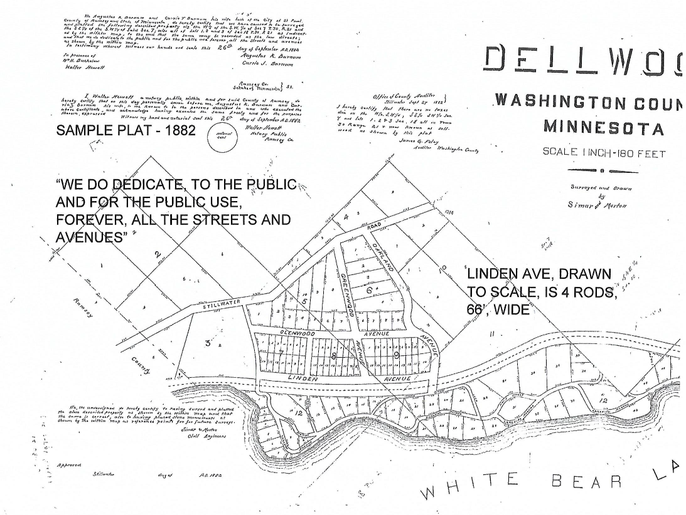

Slide 3
Quick Clarification
“LINDEN AVENUE” – A 66’ WIDE STREET IN THE ORIGINAL PLAT OF
DELLWOOD, BECAME PART OF COUNTY STATE AID HIGHWAY
IN 1925, THEN MN 244 IN 1949 -
MN 244 IS CALLED “DELLWOOD AVENUE” IN THE CITY OF DELLWOOD
LINDEN IS THAT PART OF DELLWOOD AVENUE BETWEEN MEADOW AND ORDWAY STREETS - THE “DANGER ZONE”

Slide 4
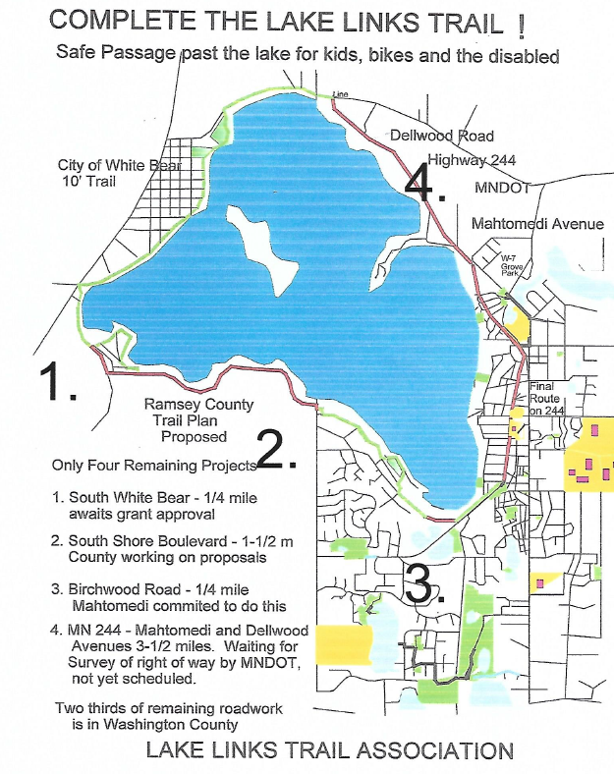
1. Old White Bear Avenue
(White Bear Lake Street)
2. South Shore Boulevard
(Ramsey County Road)
In White Bear City and Township
3. Birchwood Road
(Mahtomedi Street)
4. Mahtomedi Avenue
Dellwood Avenue
(together, MN TH 244)

Slide 5
Study Funded by Legislature Laid Out Trail Around and Past White Bear Lake 2001 Dorian Grilley, Co Chair Bob Nuffort Barbara Parent http://www.whitebearlake.org/vertical/sites/%7BD1A83686-A6D1-414A-99F1-95F5CFD97325%7D/uploads/Lake_Links_Trail_Master_Plan.pdf (Find on White Bear Lake website)

Slide 6
How Much Has Been Completed?
Public Funds built about 75% of the Lake Links Route
But Established Sidewalks in Mahtomedi and Dellwood
were abandoned and permitted to deteriorate
Now something over half the ten mile route is ready:
Lake Avenue Trail in White Bear Lake
Streetcar Trail in Mahtomedi
Small, safe streets in Birchwood
Projects 1-4, about 5 miles, remains to be completed

Slide 7
It’s Not Safe on Dellwood Avenue and South Shore Boulevard
MNDOT: MN 244 “Clearly” not safe, citing limited shoulders, steep slopes next to road, poor condition
Adam Josephson, MNDOT East Metro Area Manager
ROBERT NUFFORT, MAYOR, DELLWOOD:
“ It’s not safe! There are no shoulders and the ground drops away right next to the road. On the other side, there are telephone poles only inches from the pavement. It’s not safe!”
(Context matters – these comments were made to explain why nobody should attempt to walk through Dellwood)
Telephone conversation, March 8, 2017
GREG BARTZ, SOUTH SHORE RESIDENT
We’ve started keeping score of all the cars that crash into the guardrail at 120 and South Shore.

Slide 8
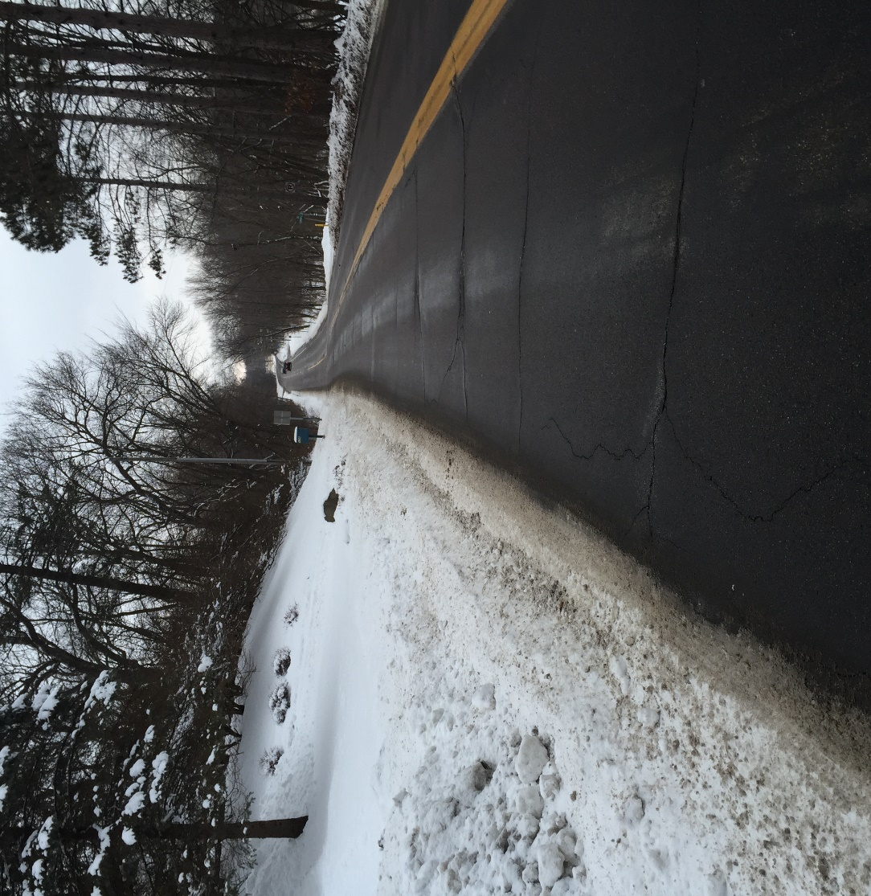
MN 244, Grove Park and West of Meadow
Would you send your grandchild?
Or your mother in her wheelchair?

Slide 9
Right of Way? Look at County GIS Map!
Brown lines delineate
public right of way

Slide 10
NW End of this stretch – (originally platted as Linden Avenue}
Brown lines delineate
public right of way

Slide 11
Even adults need special protection on 244!

Slide 12
Unsafe Roads Have Consequences
Jon Fleck, 2014
“Demolished in Dellwood”
Jon is alive and making a slow, incomplete, but remarkable recovery
No child would have survived this.

Slide 13
Why not just take a different route?
Ain’t None!
Dellwood Roads Connect to no other towns
No parallel road for Birchwood Road
No parallel for South Shore until County F
Ain’t None!

Slide 14
So, What’s Being Done?
MNDOT Promises to begin investigating right of way –
Wiger/Fisher Bill SF1231
Intended to provide preliminary engineering at sites 2,3 and 4
Funds for completion at site 1.
Resolutions of Support
Mahtomedi done, in the works in Ramsey County, Birchwood,
and White Bear Lake – others soon
Endorsements by numerous public officials

Slide 15
What Can I Do to Help?
Email your legislator or senator
Rep. Matt Dean and Sen. Roger Chamberlain
Dellwood, WBL, WB Twp, North Oaks, Hugo
Rep. Peter Fischer and Sen. Chuck Wiger
Mahtomedi, Birchwood, Willernie, s part White Bear Lake, North St. Paul
Rep. Kathy Lohmer, Sen. Karin Housley
Grant, Pine Springs
Call your mayor or council to support
List of contact information available

Slide 16
Are you feeling patient?
135 years since dedications provided a route available “to the public, and for the public use, forever”
67 years since MNDOT took over roads with working sidewalks, gone now
25 years since the ADA promised disabled Americans access and
personal mobility
16 years since all communities joined in the Lake Links Study, and
still no path.
WE HAVE WAITED LONG ENOUGH!

