Slide 1
1899 Bike Path Around White Bear Lake

Slide 2
WHY NOT NOW?

Slide 3
What is the Lake Links Route?
A safer path past and around White Bear Lake

Slide 4
What is the Lake Links Route?
A safer path past and around White Bear Lake
For children, adults, bicyclists, pedestrians and the disabled – everyone

Slide 5
What is the Lake Links Route?
A safer path past and around White Bear Lake
For children, adults, bicyclists, pedestrians and the disabled – everyone
A blending of many types of paths
On road in Birchwood
Sidetrail/one way on Lake Avenue
Paths in the woods, Streetcar Trail, Railroad Right of Way, Rutherford Park
Sidetrails to busy roads, some of Mahtomedi and Dellwood
Yet to be determined – South Shore Boulevard

Slide 6
Who is Lake Links?
An association of citizens – meeting each month to effect change
A steering committee with members from all communities
Fiscally sponsored by Greater White Bear Lake Area Communities Foundation – “GUACAMOLE” to me
Linked to the Mahtomedi Area Green Initiative (MAGI)
Founded in February 2017, though work went on before

Slide 7
WHERE?

Slide 8
WHY THE LAKE LINKS ROUTE?
SAFETY
Working for: Free-standing trail where possible
Vertically separated side trail where that can’t be done
Advocating: Better and more frequent crosswalks
Pedestrian operated if possible
Education and Enforcement – speed and crosswalks
Lowering speeds, both legally and by environment
Protecting from high-volume traffic
(e.g. 11,000 cars per day on MN 96)

Slide 9
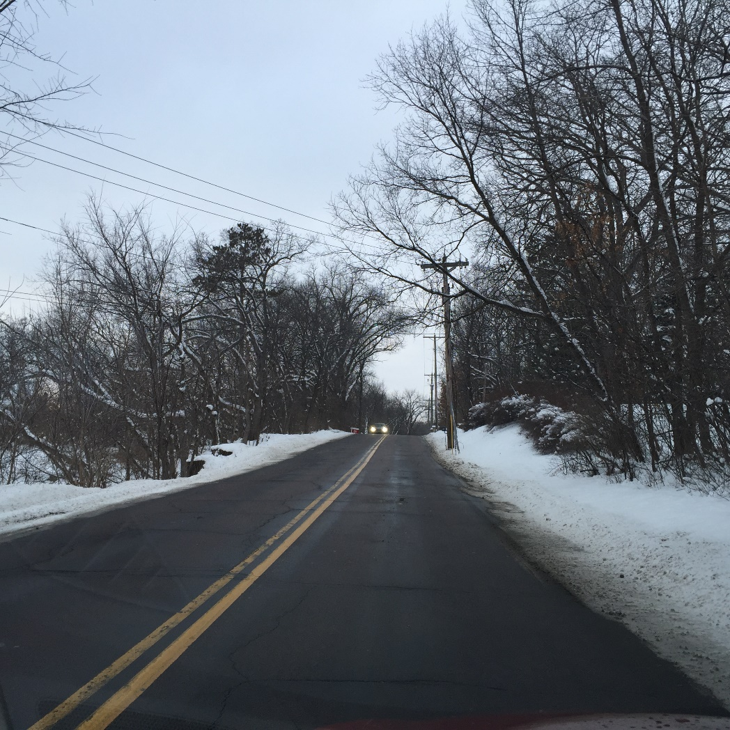
WHY? - SAFETY!
POWER POLES
RIGHT NEXT TO ROADS!

Slide 10
SAFETY – ONLY CROSSWALK FOR A MILE TO THE NORTHWEST – 2 MILES TO SOUTHEAST

Slide 11
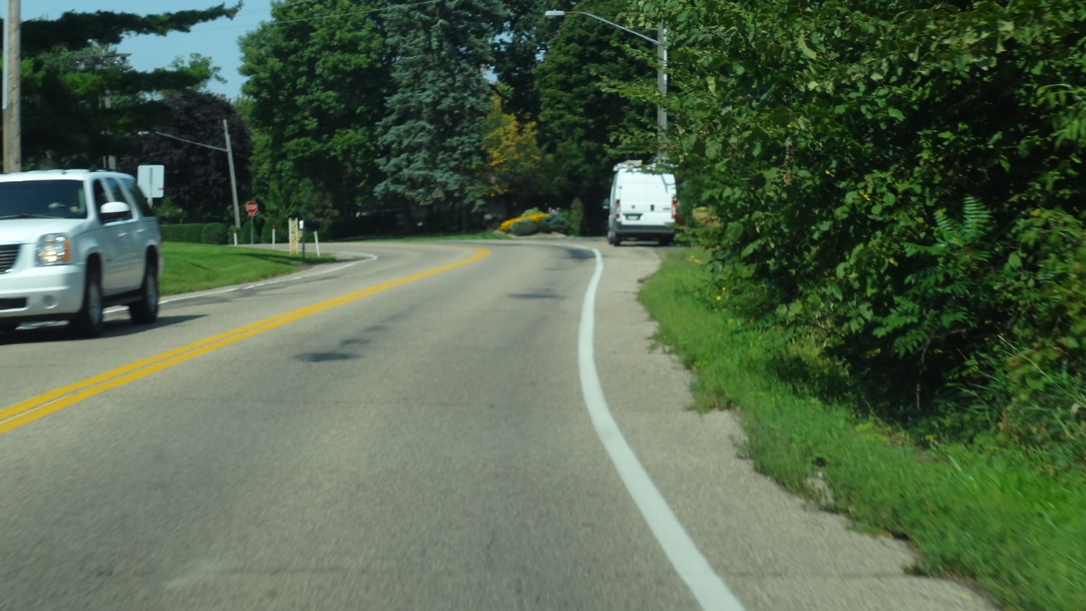
NARROW SHOULDERS - BUSY ROADS

Slide 12
WHY THE LAKE LINKS ROUTE?
BEAUTY
The Lake Links route has beautiful water vistas and quiet, tree-lined pathways. It passes ponds, creeks and interesting houses and buildings.
Please see the Lake Links Photo Tour at www.Lakelinks.net
A few pictures are here:

Slide 13
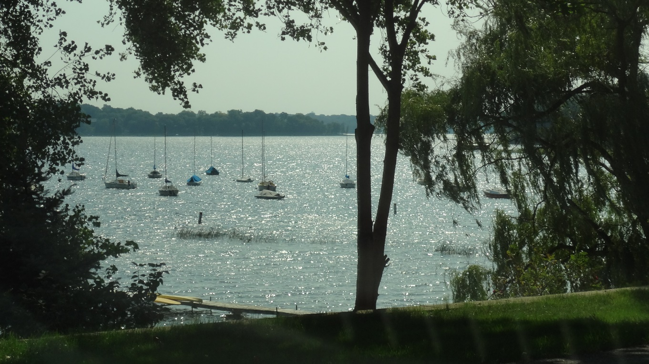
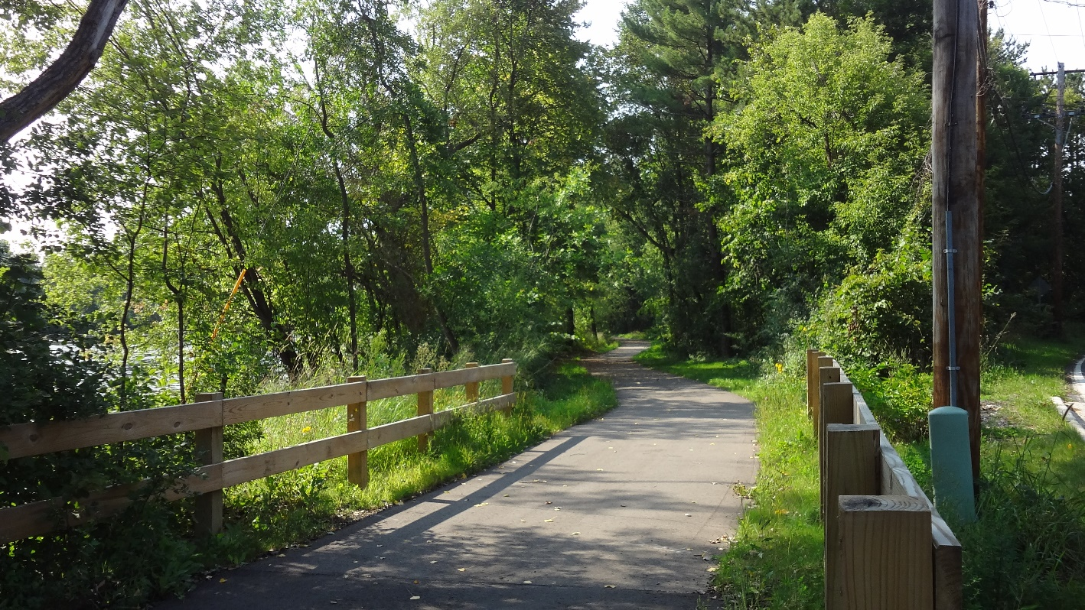

Slide 14
?
WHY LAKE LINKS?
COMMUNITY!

Slide 15
WHY THE LAKE LINKS ROUTE?
4. HISTORY
History abounds in our area, from native American practices and burial mounds; through the early resort eras of large hotels and visitors from hot southern states; with influences of religion in the founding of churches and the establishment of the Chautauqua.
Growth continued with streetcars connecting to St. Paul, highlighted by a huge amusement park, and spiced with the presence of infamous American criminals in the 1930’s.

Slide 16
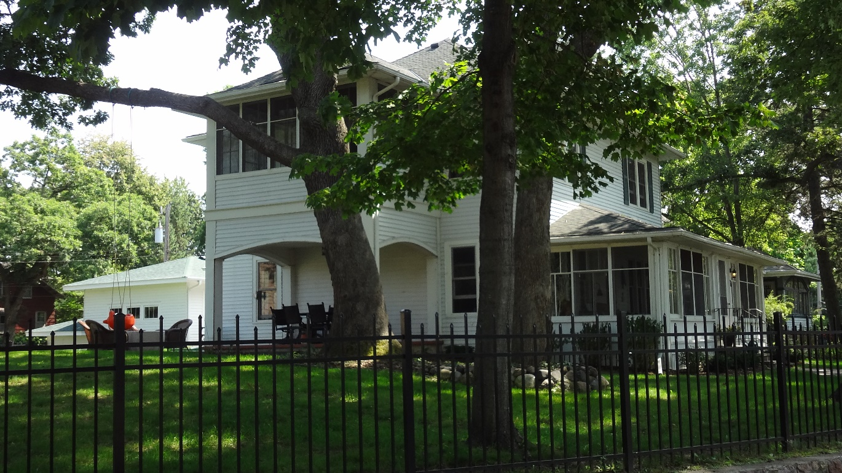
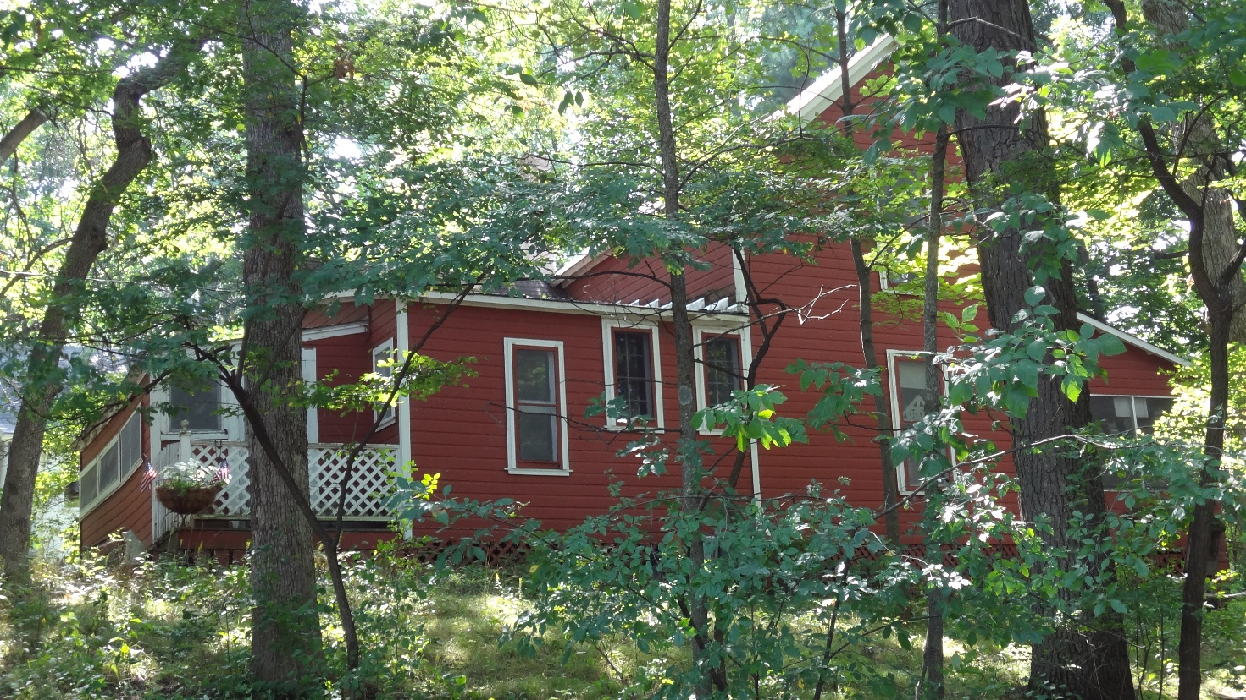
FILLEBROWN HOUSE CHAUTAUQUA HOTEL KNOPP COTTAGE

Slide 17
WHAT HAS BEEN DONE?
Lake Avenue – One way with beautiful side trail – last piece soon done
Streetcar Trail – Free-standing path in the woods, completed 2016
Identification of small street routes in Birchwood
Funding by Legislature of Lion’s Park to South Shore (2018)
Funding by Legislature of Preliminary Engineering
MN 244 (Mahtomedi and Dellwood Avenue) /
Birchwood Road and Hall Avenue / Starting Soon
South Shore Boulevard /
Surveying and responsibility for right of way – MNDOT (244)
Planning for South Shore Improvements – Ramsey County
Identification of Rutherford Park and Trail , cleanup begun WBTwp
Public Support from all communities and governments!
Private donations of additional right of way – more under discussion
Technical Standards Established
75 person bike ride on Trails Day, Historic Walking Tours Ahead

Slide 18
What are the remaining issues?
FUNDING – We hope for continued legislative support for this project which involves five communities, two counties, many agencies
Right of Way – We can use some help at critical spots to make this even better.

Slide 19
What is the schedule?
Rutherford Park – work going on now
Signage in Birchwood, Streetcar Trail 2017
Old White Bear Ave -2018
Work on off-road sections, some this fall, and 2018
South Shore Boulevard 2019
Additional improvements along MN 96 - 2018
Road Adjacent Improvements to MN 244 – 2020
Complete Route – October, 2020.

Slide 20
Contact Information
Website: www.lakelinks.net (a work in progress)
Steve Wolgamot, Washington County Chair
kwolgamot@Comcast.net
612 209 6121
Mike Brooks, Ramsey County Chair
nebikewalk@gmail.com

Slide 21
Thank You!
Legislature – Senator Wiger, Reps Fischer and Dean
MNDOT – Commissioner Zelle, Adam Josephson, Survey Crew
Mahtomedi, White Bear Lake, White Bear Township, Birchwood, Dellwood, Willernie, Hugo, Pine Springs
Ramsey County, Commissioners Reinhardt and Huffman
Washington County Commissioners Miron and Karwoski
Staff of all these organizations
Thane and Blanche Hawkins

